Slide 1

Sports Analytics III
Produced by Dr. Mario
UNC STOR 538

Slide 2
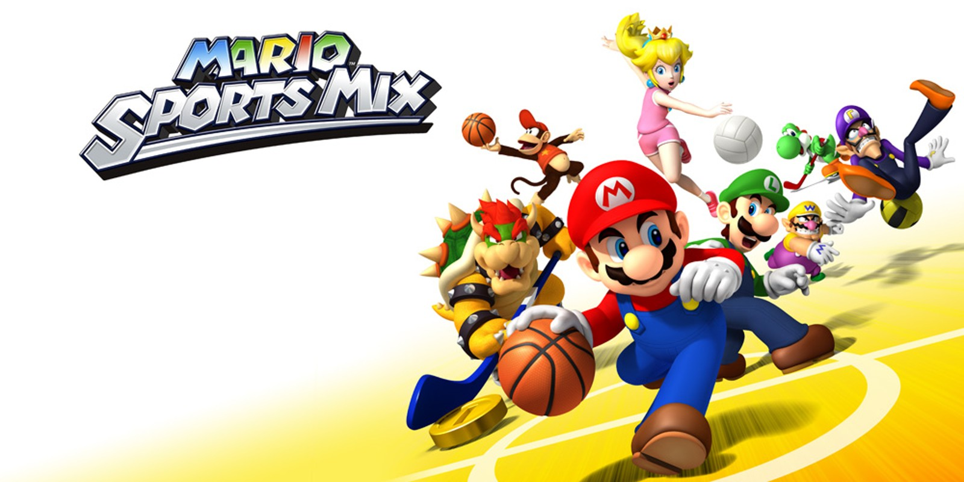
Industry Past
Sports Analytics Use Survey (2013)
Sample of 27 People (NFL, MLB, NBA, EPL)
How Many Different Sources?
1-2 (6.7%)
3-4 (33.3%)
5-6 (13.3%)
>6 (46.71%)

Slide 3
Industry Past
How Much Data is Centralized?
All (31.3%)
Most (37.4%)
Some (31.3%)
How Much Data is Dependent on One Person?
Some (50.0%)
Most (43.7%)
All Data Centralized (6.3%)

Slide 4
Industry Past
Is Data Checked for Errors?
Always (31.3%)
Usually (37.5%)
Sometimes (18.8%)
Occasionally (6.1%)
Rarely (6.3%)
How Many Database Programmers are Employed?
0 (37.5%)
1-2 (50.0%)
3-4 (0.0%)
>5 (12.5%)

Slide 5
Industry Past
How Many Statistical Analysts are Employed?
0 (20.0%)
1-2 (66.6%)
3-4 (0.0%)
>5 (13.3%)
Roadblock: Difficulty Identifying Strong Applicant
Difficulty in Both Hiring and Evaluating

Slide 6
Industry Past
Clear Process for Hiring/Evaluating Analysts
Strongly Agree (13.3%/14.3%)
Somewhat Agree (13.3%/14.3%)
Neutral (26.7%/28.6%)
Somewhat Disagree (13.4%/21.4%)
Strongly Disagree (33.3%/21.4%)
Analytic Resources in Line with Strategic Game Plan
Strongly Agree (26.7%)
Somewhat Agree (33.3%)
Neutral (33.3%)
Strongly Disagree (6.7%)

Slide 7
From Past to Present
Ben Alamar Updated Survey in 2nd Edition
163 People, 119 Orgs., 15 Sports
53% Use Statistics Regularly in Decision Making
58% Report Data is Mostly/Fully Centralized
32% Say Data is Regularly Presented Clearly and Consistently
83% Confirmed Analytics Group Will Grow in Next 5 Yrs.
Notable Differences Since 2013
Larger Datasets (Million Rows Per Game)
Due to Player Tracking (Approx. 25 Measurements Per Sec)
Measurements Across Whole Body
Speed at Which Questions Can be Answered is A Lot Faster

Slide 8
Industry Present
Value Placed on Sports Analytics
Business Research Company Analysis
Global Sports Industry $470.42B to $495.38B
Actual CAGR of 5.3%
Expected to Grow to $617.57B in 2029 (CAGR 5.7%)
Deloitte Article Sports Analytics Industry Trends 2024
Fan Data Aggregated and Managed
Increased Use in Generative AI

Slide 9
Industry Present
Value Placed on Sports Analytics
Grand View Research on Sports Analytics Market
Valued at $3.52B in 2023 and $4.47B in 2024
Expected CAGR Between 2025 and 2030 is 20.6%
Software Segment Dominates Services
On-Field Analytics Dominates Off-Field Analytics
$Projection in 2030=5.68∗(1+CAGR)^5$ =14.49
$14.49B
$4.47B
$5.68B
2024
2025
2030

Slide 10
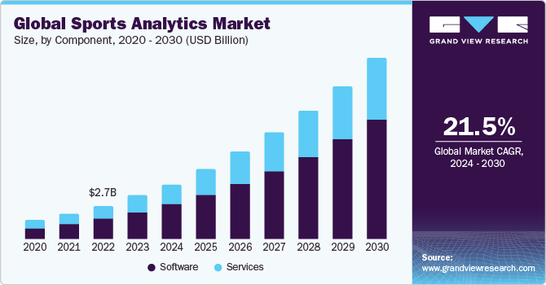
Industry Present
Value Placed on Sports Analytics
Grand View Research on Sports Analytics Market

Slide 11
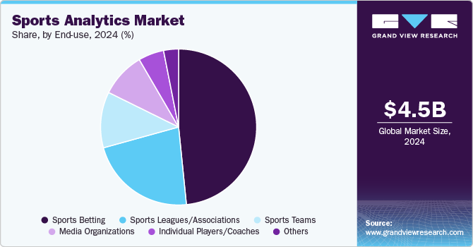
Industry Present
Value Placed on Sports Analytics
Grand View Research on Sports Analytics Market

Slide 12
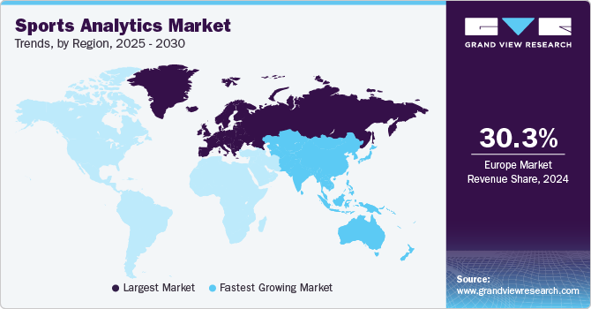
Industry Present
Value Placed on Sports Analytics
Grand View Research on Sports Analytics Market

Slide 13
Industry Present
Value Placed on Sports Analytics
Grand View Research on Sports Analytics Market
Agile Sports Analytics, LLC
Catapult Sports
ChrynoHego Corporation
Deltatre
Experfy Inc.
Genius Sports Group
IBM Corporation
Oracle Corporation
SAP SE
Aercont Vision Coaster LLC
The Sportradar Group
Stats LLC

Slide 14
Industry Present
Modern Applications of Sports Analytics
Forbes Article from 2021 by Abhas Ricky
Helping the Team Win
Automated Video Analysis (Lincoln City, UK Football)
3D Depth Camera (NBA)
Wearable Technology (NBA, NHL)
Improving the Fan Experience
Analysis of Digital Engagement
Sentiment in Social Media
Analysis of Fan Behavior in Stadium (New England Patriots)
Wireless Internet and Phone Apps
Apps Supply Game Analytics, Parking Information, Promotions, and Traffic Information to the Fans (NFL)

Slide 15
Industry Present
Modern Applications of Sports Analytics
Benefiting Other Stakeholders
Tracking Fan Behavior Outside the Stadium
Telecommunication, Retailers, Payment Providers, Ticket Agencies, and Sponsorships
Adapt to Quick Changes in Consumer Behavior
Optimizing the Back-Office
HR Practices
Game Scheduling
Supply Chain Management and Logistics
Marketing and Promotions
Procurement of Goods and Services

Slide 16
Industry Present
Modern Applications of Sports Analytics
Advancing Sports Gambling
Supreme Court Ruling Previous Statute Violated 10th Amendment (Murphy v. National Collegiate Athletic Association)
States Free to Legislate Gambling
Improvement of Gambling Products
Data Aggregation and Visualization for Bettors
Develop Daily Fantasy Sports
Grandview Research of US Market
US Market Valued at $17.94B in 2024
Expected CAGR of 10.9% from 2025 to 2030
$$Projection in 2030=19.76∗{\left(1+0.109\right)}^{5}=\$33.15B$$

Slide 17
Your Industry Future
Prerequisites by Howard Hamilton
(Soccermetrics)
Technical Skills
Mathematics (Linear Algebra/Probability Essential)
Statistics (Frequentist and Bayesian Perspectives)
Machine Learning (Supervised and Unsupervised)
Programming (R/Python, Data Structures, OOP)
Databases
Visualization
Socials Skills, Ethics, and the Law
Knowledgeable About All Aspects of the Sport

Slide 18
Your Industry Future
Real Jobs (Builtin.com)
Data Engineering, DraftKings
Former 538 Student Works There
3+ Years Experience
Proficiency in SQL, Snowflake, Tableau
Tools: Kafka, Airflow, Terraform, Python, Datadog
Lead Analyst, DraftKings
4 Years in Analytics or Data Science
Bachelors Degree in STEM
SQL, EXCEL, TABLEAU, R, Python

Slide 19
Your Industry Future
Real Jobs (Builtin.com)
Basketball Data Scientist, Swish Analytics
Betting and Fantasy Startup in San Francisco
Bachelors Degree in STEM; Masters Preferred
Advanced Knowledge of Math and Statistics
SQL/Python/GitHub/AWS
Database Adminstrator, Sporty Group
Company from London (Remote Option)
Managing Database, Queries, Dashboards
MySQL and MongoDB
AWS, Redshift

Slide 20
Your Industry Future
Real Jobs (Builtin.com)
Sr. Data Engineer, Boston Red Sox
Bachelors Degree in CS-related Field
Strong SQL Experience
Snowflake, DBT, GraphQL
Lead Data Scientist, Dicks Sporting Goods
Not Entry Level
Elastic, SOLR
Engineering of APIs
TensorFlow, PyTor

Slide 21
Your Industry Future
Real Jobs (ZipRecruiter)
Quantitative Analyst, Philadelphia Phillies
Focus on Computer Vision and Machine Learning
BS, MS, or PhD in STEM
PyTorch, TensorFlow, Keras, OpenCV

Slide 22
Your Industry Future
Real Jobs (tealhq.com)
Associate (Intern), Milwaukee Brewers
Baseball Research and Development
Develop Visuals and Other for Disseminating Analytical Results
BS or Working on BS in STEM
Analyst, Minnesota Twins
Advanced Scouting
Travel with Team
In-Game Strategy
R, Python, MATLAB, Julia, STAN,
SQL

Slide 23
Your Industry Future
Conferences
MIT Sloan (March)
International Sports Analytics Conference (July)
UConn Sports Analytics Symposium (April)
OSU Sports Analytics Conference (April)
Carnegie Mellon Sports Analytics Conference (?)
New England Symposium on Stat. in Sports (2025)
Great Lakes Data and Analytics (April)
International Conference on Sports Analytics and Data Visualization (August)
More International Conferences (See Link on Website)

Slide 24
Final Inspiration
Defense wins championships.
Offense wins contracts.
Be offensive.
- Mahatma Mario

